Slide 1
SMART INDIA HACKATHON 2020
Ministry And Organization Name : Govt Of Bihar (DOA)
Team name : IT EMPIRER
Team leader : Balaji.G
Team members : Prakash P
Tamilarasan E
Vignesh N
Vijaychitra V
Aathirai J
College Code : 4216
Problem Statement: NS275
College Name : Mailam Engineering College

Slide 2
ABSTRACT
To develop a application by using a machine learning model to predict the soil type and temperature, humidity, rainfall.
a solution for farmers of the Bihar to suggest what crops are grown in a particular area.
Already they cropped means how much they yield for those crops
Try to predict the flood in Bihar by the rainfall pattern in Bihar and using some air brushes

Slide 3
INTRODUCTION
In Bihar the average annual rainfall is 1,326and 1,186(mm).
76% population in the North Bihar living under the recurring threat of flood devastation.
16.5% of India's flood affected area and 22.1% of India's flood affected population.
73.06% of Bihar's geographical area, ie 68,800 square kilometres (26,600 sq mi) out of 94,160 square kilometres (36,360 sq mi), is flood affected.

Slide 4

PROBLEM STATEMENT
Agriculture is at the core of Bihar’s economy, With 88% of the state’s poor living in rural areas
Major crops grown in Bihar are rice, wheat, maize, gram, red gram, sugarcane, potato & other vegetables.
The agricultural sector in Bihar is plagued with numerous, and well known, constraints and problems.
To overcome the problem, we develop a real time land usage monitoring tool using satellite data and artificial intelligence.

Slide 5
LIST OF SOIL TYPES IN BIHAR
Types of Soil | Area | Properties of the soil
Balthar | Kaimur | Sandy, calcareous, yellow
Tal | Patna and Munger | Heavy soil
Terai | Champaran and Kishangunj | Sandy, calcareous, brown and light yellow
Bhangar | Patna, Gaya and Rohtas | Acidic and rich in lime
Khadar | Muzaffarpur, Purnia, Saharsa, Dabhanga and Bhagalpur | Drank brown and fertile
Bal Sundari | Saharsa, East and West Chamaparan | Lime and alkaline

Slide 6
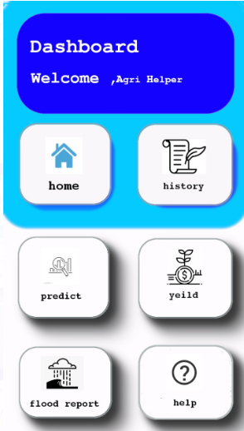
DASHBOARD UI OF APPLICATION

Slide 7
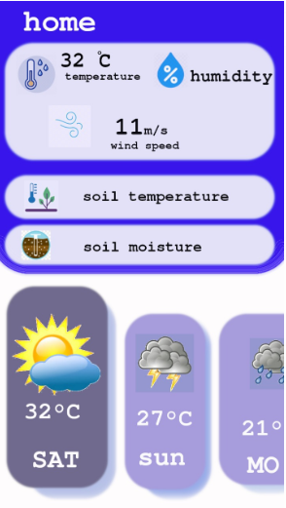
HOME MENU

Slide 8
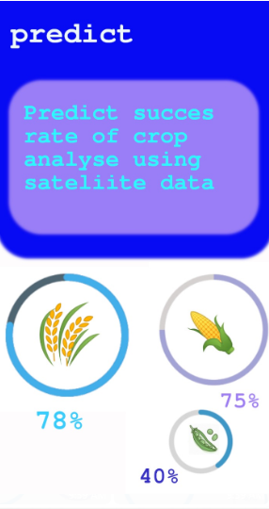
PREDICTION OF THE CROP

Slide 9
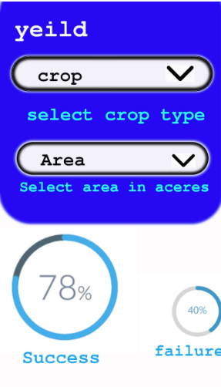
SELECT CROP AND AREA

Slide 10
TECHNOLOGIES USED
Accuweather API
  To get current weather of an location
Sequential Neural Network
  Predicting the Rainfall
Convolutional Neural Network
  Finding the Land types
Cat boost
  Predict the crop yield

Slide 11
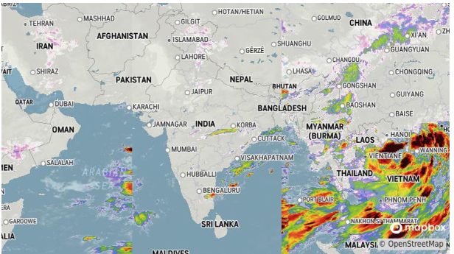
ACCUWEATHER API
Accuweather is used to get current weather of an location given by an user.
An API that providing free weather report.

Slide 12
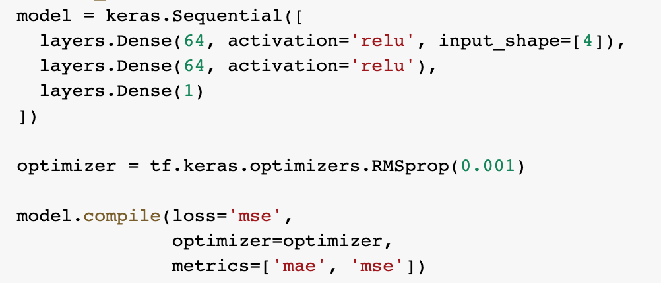
SEQUENTIAL NEURAL NETWORK
A Sequential model is appropriate for a plain stack of layers where each layer has exactly one input tensor and one output tensor.
Using SNN for predicting the Rainfall.

Slide 13
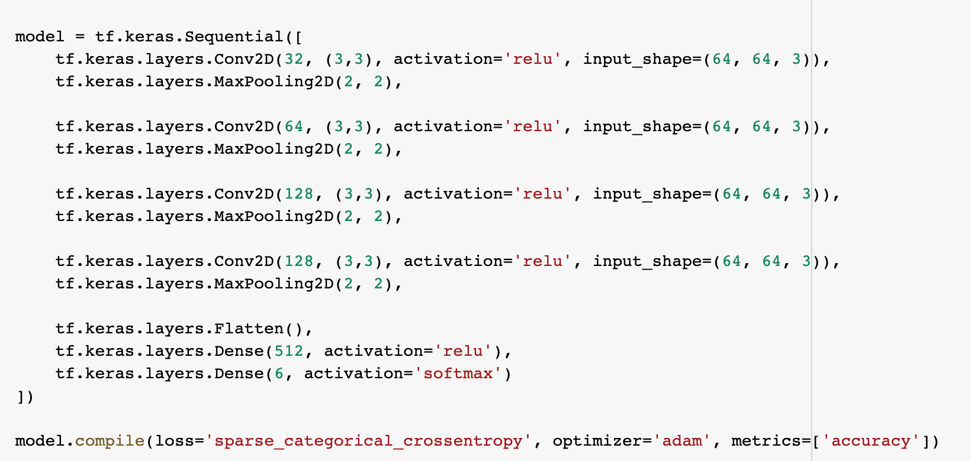
CONVOLUTIONAL NEURAL NETWORK
CNN is a class of deep neural networks in deep learning.
Most commonly applied to analyzing visual imagery.
using CNN for finding the Land is Highway, Forest, Agriculture land, Desert, River or Industry .

Slide 14
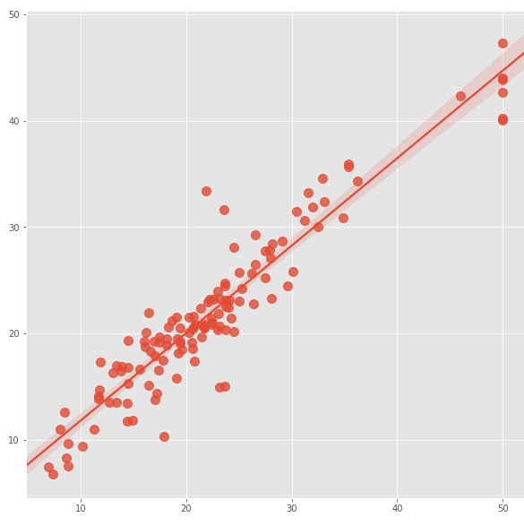
CAT BOOST
Training and applying models for the regression problems.
When using the applying methods only the predicted class is returned.
Cat Boost is used in over project for predict the crop held.
By taking the amount of area croped and current rainfall rate.

Slide 15
THANK YOU

